Slide 1
Introduction to Soft Robotics Autumn 2022 Instructors: Ahmad Rafsanjani, Jonas Jørgensen
19 September 2022

Slide 2
Tutorial 3: Pumps and valves
19 September 2022

Slide 3
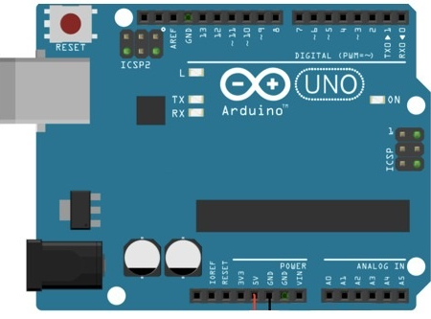
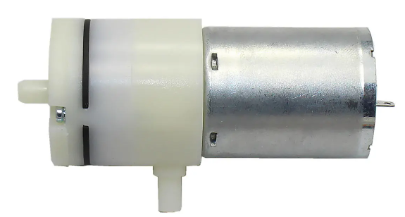
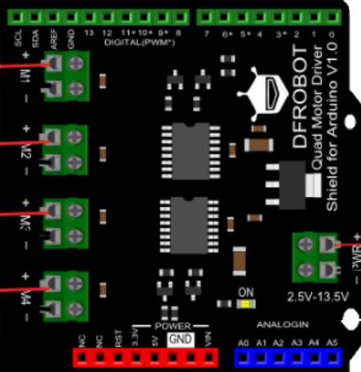
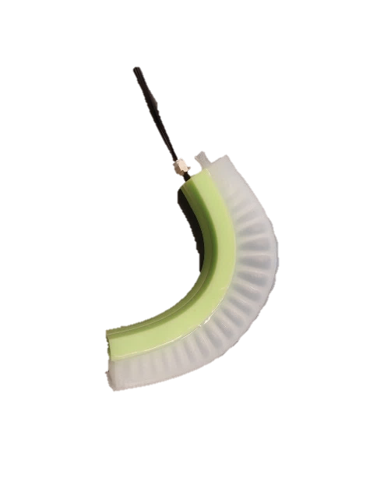

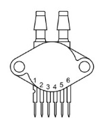
Pump 1 (M1)
Valve 1 (M2)
MPX5100 pressure sensor
Figure 2. Pneumatic system for two PneuNets and MPX5100 pressure sensor using DFROBOT motor driver for Arduino Uno
19 September 2022

Slide 4
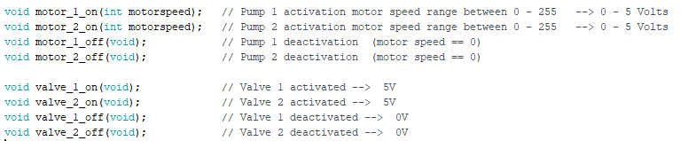
Code Information
Arduino Code
Download Pump_valve_simple_control sketch at GitHub Link
Arduino Motor controller functions
Arduino Time Control:
Sample time = 100 [ms]
19 September 2022

Slide 5
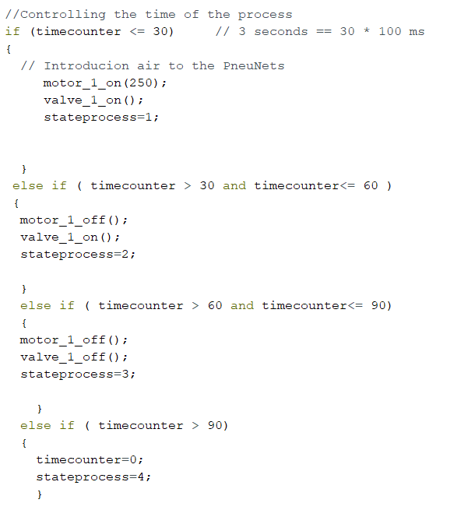
Code Information
Arduino Time Control:
Sample time = 100 [ms]
Example:
19 September 2022

Slide 6
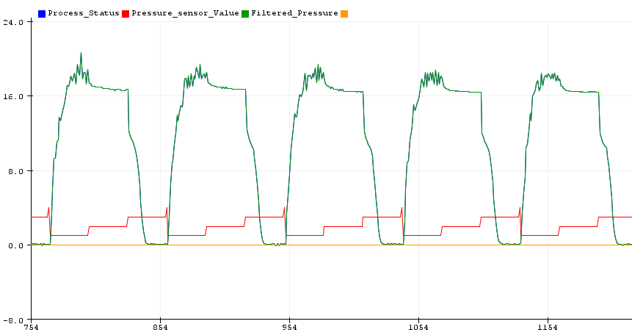
Alpha filter

Slide 7
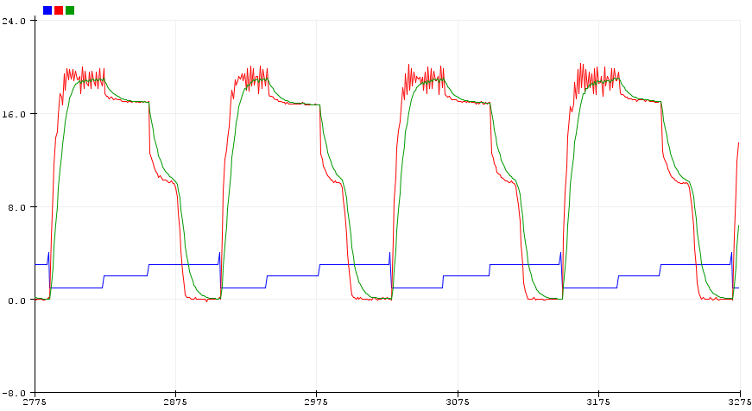
Alpha filter
19 September 2022

Slide 8
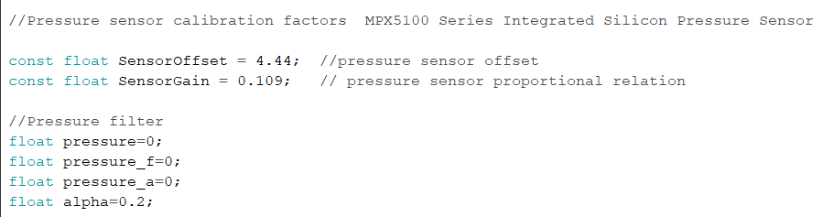
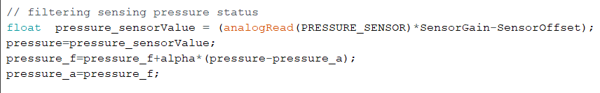
Alpha filter
19 September 2022

Slide 9
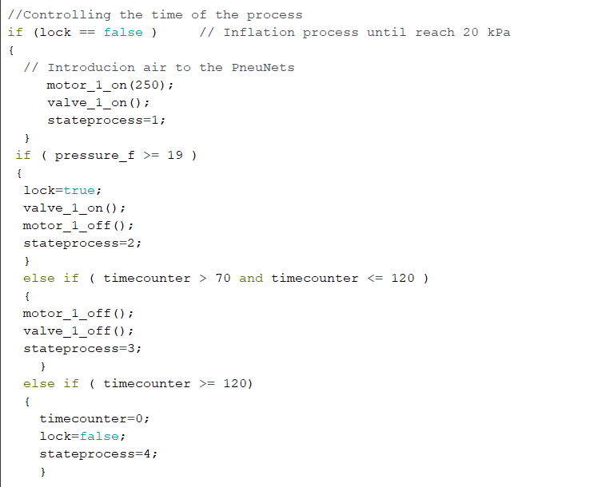
Pressure controller
19 September 2022

